Slide 1

Breaking the Echo Chamber: Analyzing Political Bias in News Media
Gautham Gali, Seshadri Kakani, Yash Rathi

Slide 2


2. OBJECTIVE
1. PROJECT INTRODUCTION
4. METHODOLOGY
3. SYSTEM ARCHITECTURE
Presentation Overview
5. BIAS DETECTION AND ANALYSIS WITH LLM
8. FUTURE WORK
6. MODEL EVALUATION
▶ CONTINUE TO IR MODULE AND DEMO
7. MODEL PERFORMANCE

Slide 3
Authors are trying to inform the public but they have their own thoughts and biases.
Bias in inherent in news
Bias has increased with the advent of social media, economic pressure on traditional media outlets, and political polarization
INTRODUCTION
Clicks based rewards(Social Engagement, click bait, and advertising revenue)
Bias causes the distortion of truth, increases skepticism, and polarization
Understanding bias is critical for the reader to make informed decisions about the news that is presented to them.

Slide 4
TYPES OF BIAS
Linguistic Bias
Text-level Context Bias’
INTRODUCTION
Reporting-Level Context Bias
Cognitive Bias
Hate Speech
Racial Bias
Fake News
Gender Bias
Political Bias

Slide 5

Text’s political leaning or ideology, potentially influencing the reader’s political opinion and, ultimately, their voting behavior (Huddy et al., 2023)[1].
Political Bias
Left | Center | Right
Left Leaning | Center | Right Leaning
Left |  | Right

Slide 6
Leverage cutting-edge large language models (LLM) along with classical information retrieval techniques to analyze news content, classify its political bias and provide clues and reasoning to guide users toward information representing balanced viewpoints.
We aim to encourage critical thinking, enhance users' decision-making capabilities, and provide them with tools for analyzing bias in news. We want to empower individuals to engage with the news they consume.
OBJECTIVE

Slide 7
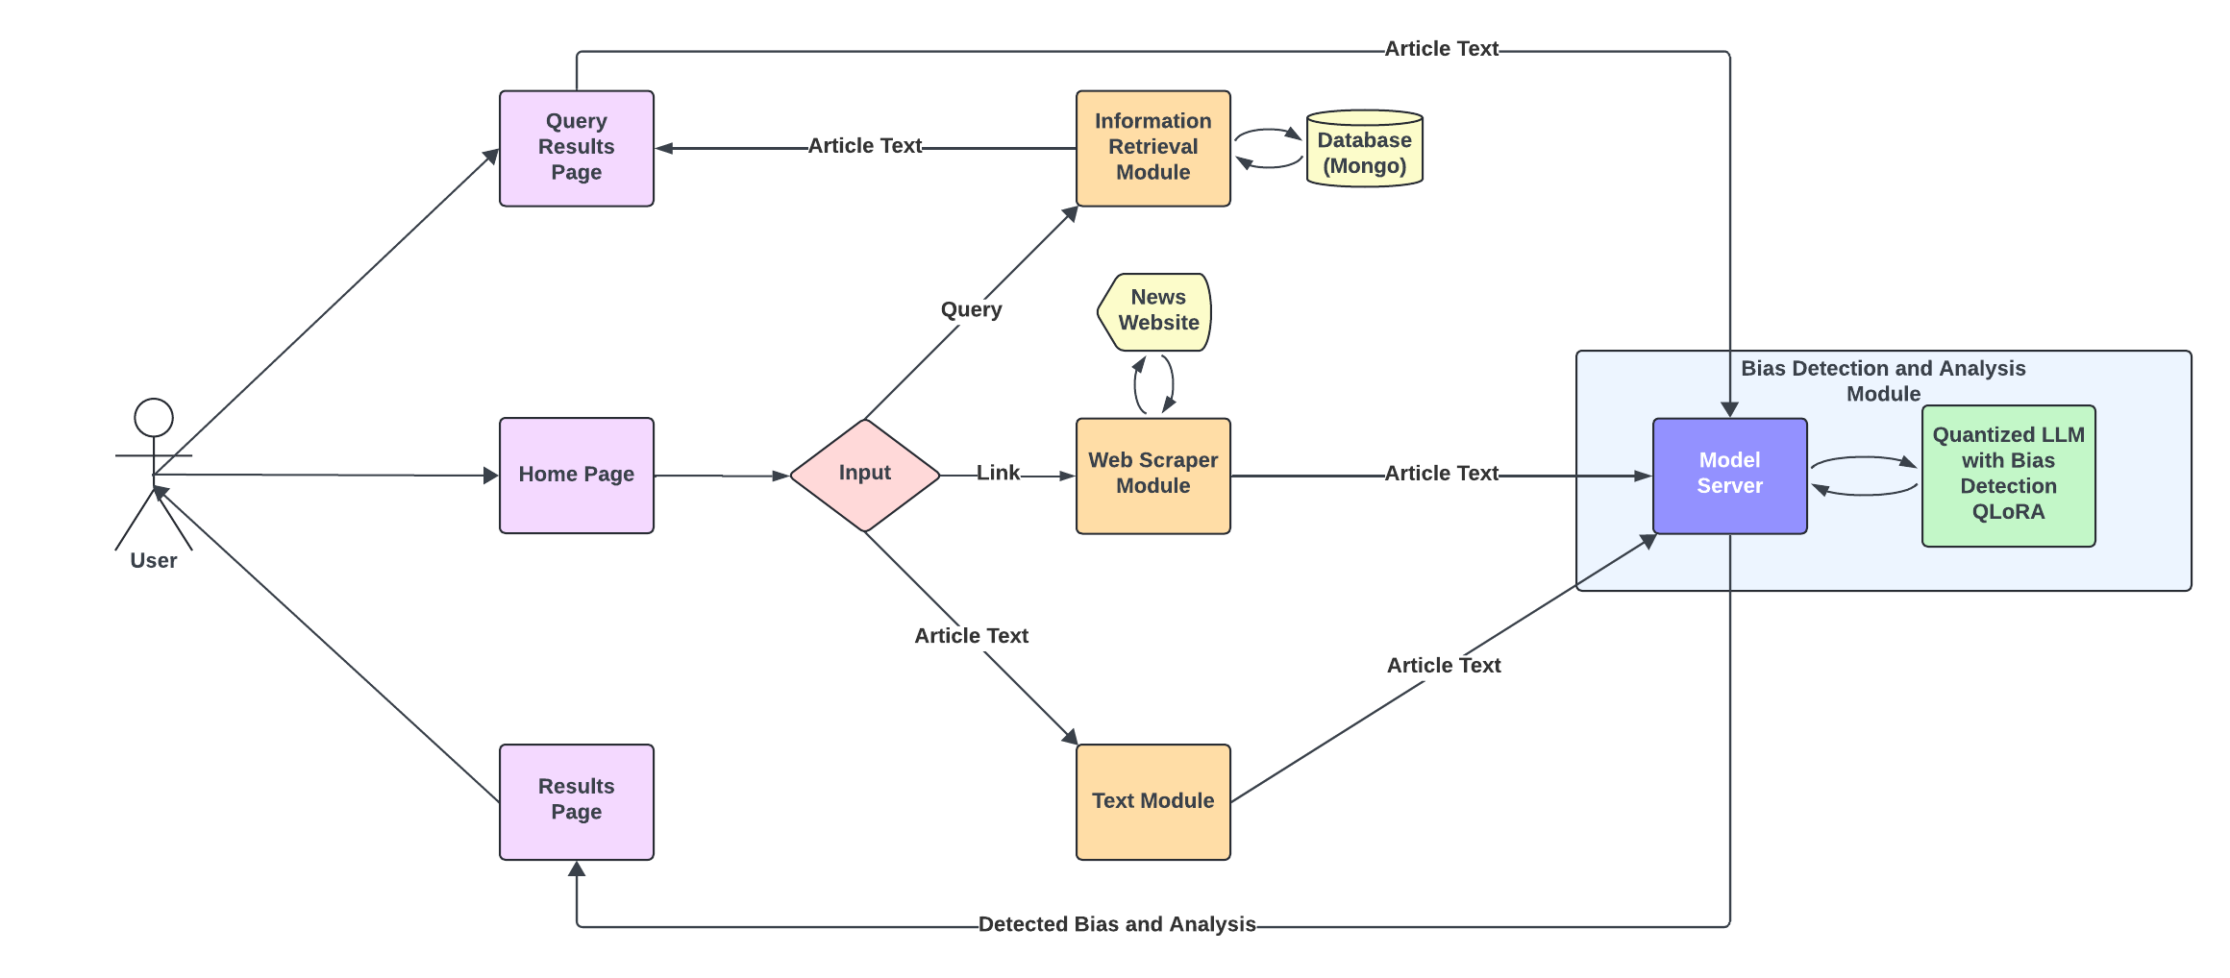
SYSTEM ARCHITECTURE

Slide 8
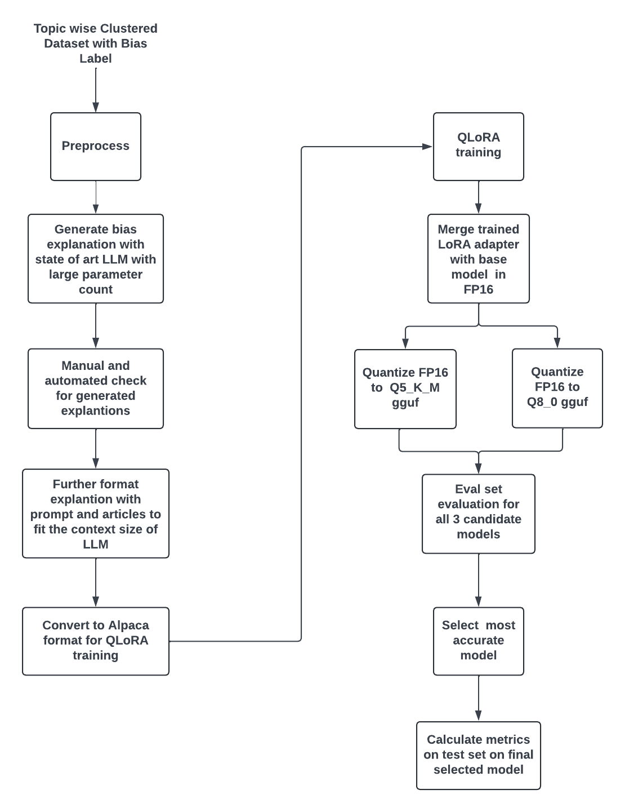
METHODOLOGY
Dataset – subset of BIGNEWS.
LLM for explanation generation - Qwen1.5-72B-Chat-AWQ (32k Context length)
Base model for finetuning - Llama 8b and Gemma 7b
QLoRA training – Unsloth
Quantization to gguf – Llama.cpp
Metrics – sklearn
GPU – A100 (80 GB), RTX 3090 (24 GB), Tesla T4 (16 GB)

Slide 9

BIAS DETECTION AND ANALYSIS WITH LLM

Slide 10
Dataset
BIGNEWSALGN – 1 million clusters (~20 GB JSON)
Aligned to cover articles reporting same story. Same story with 3 different biases. Cosine similarity for TF-IDF vectors.
1. Format dataset to get labels for “Lean Left” and “Lean Right”.
2. Remove outliers (i.e. very long or very short articles).
3. Only pick clusters which has articles from all 5 biases. Format to keep only keep 5 articles in each cluster.
4. Due to resource constraints we only pick 2100 articles (420 clusters) from preprocessed 35K cluster for training. Eval set was 300 articles (60 clusters) and Test set was 700 articles (140 clusters).
5. Generate explanations from LLM model for train set. Give LLM 5 variations of each article for better context along with bias label. Format to Alpaca instruction format.

Slide 11
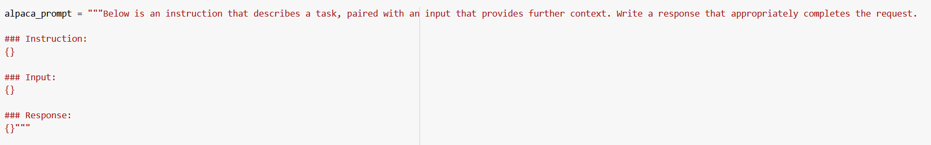
Dataset

Slide 12
Dataset
Sample prompt, sample explanation and sample dataset
All finetuned models at - zz-xx (Yash) (huggingface.co)

Slide 13

MODEL EVALUATION

Slide 14
Evaluation
Final selected model – Gemma7b_q5_k_m

Slide 15
Information Retrieval System
Database
Common Crawl
Corpus of raw web page data, metadata extracts, and text extracts
Updated monthly and stored in AWS S3 bucket.
Preprocessing
Receive Json format files from common crawl.
Remove publisher name, stop words, and punctuation from the text.
Conduct Stemming
Vectorize the text and title using scikit-learn TfidfVectorizer.
Store the content, title, processed text, and vector into MongoDB.
Retrieval
o Query provided by user.
o Preprocess Query by removing stop words and punctuation.
o Use Cosine Similarity to return the 10 highest ranked articles.

Slide 16
Web Scraper
URL provided by user.
Determine which scraper to use.
CNN
Fox
Washington Post
USA Today
Uses BeautifulSoup to return the value of the tags specified.
Returns Title and Content news article.
Processes Text
Remove unwanted characters and excessive spaces.
Sends title and content to LLM for analysis.

Slide 17
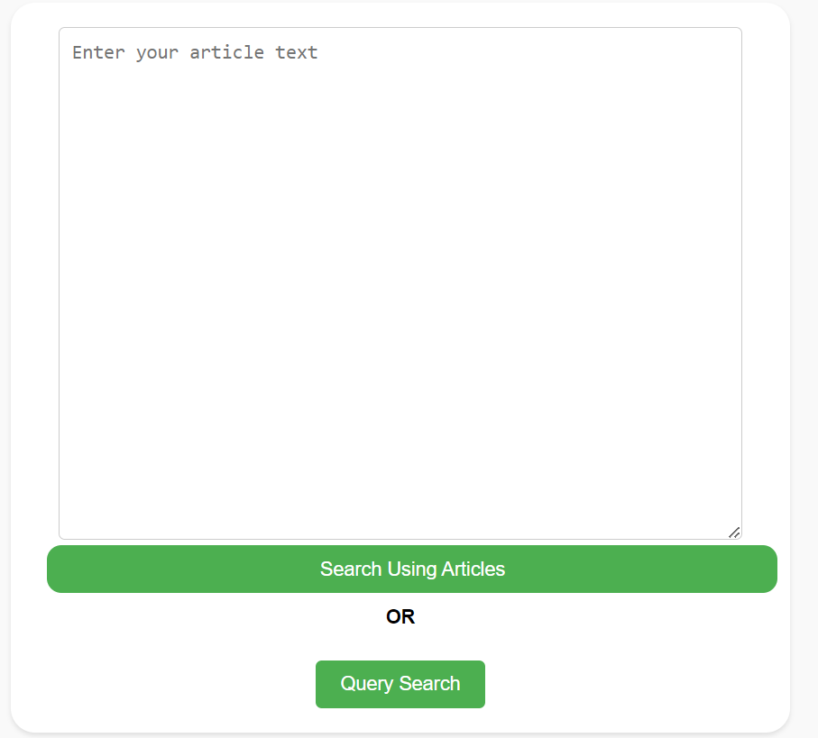
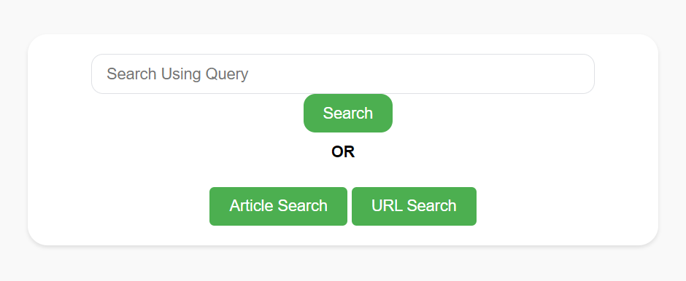
UI
We have used HTML, CSS for frontend.
Backend is hosted on flask server.
Database Mongo

Slide 18
UI
We have used HTML, CSS for frontend.
Backend is hosted on flask server.
Database Mongo

Slide 19

UI Demo

Slide 20

QUESTIONS AND COMMENTS

Slide 21
THANK YOU!
Professor, TAs and Students.

Slide 22


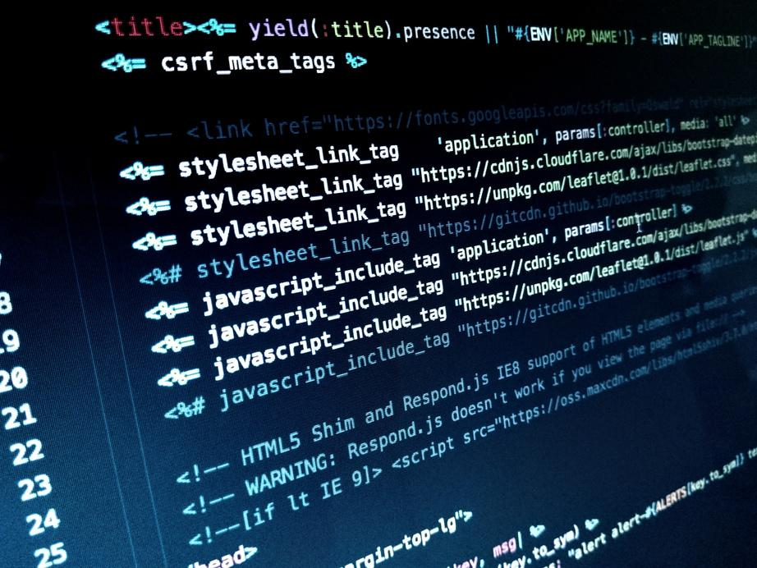
REFERENCES

Slide 23
Related work

Slide 24
ML model used
LogisticRegression
Random forest model
Gradient boosting model
MLPClassifier
Neural Network using tensorflow, keras
LSTM

Slide 25
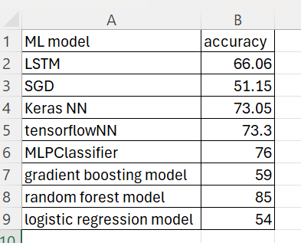
ML model used

